Slide 1

Week 5: Layout Widgets
Row, Column, Stack, & Card
Flutter Mobile Application Development

Slide 2
Learning Objectives
1
2
3
Layout Roles
Alignment Mastery
Layering Widgets
Understand specific roles of layout widgets.
Master horizontal/vertical alignment with Row & Column.
Learn to layer widgets using Stack.
4
5
Group Information
Responsive Spacing
Use Card widgets for visual elevation.
Introduction to Expanded for flexible layouts.

Slide 3
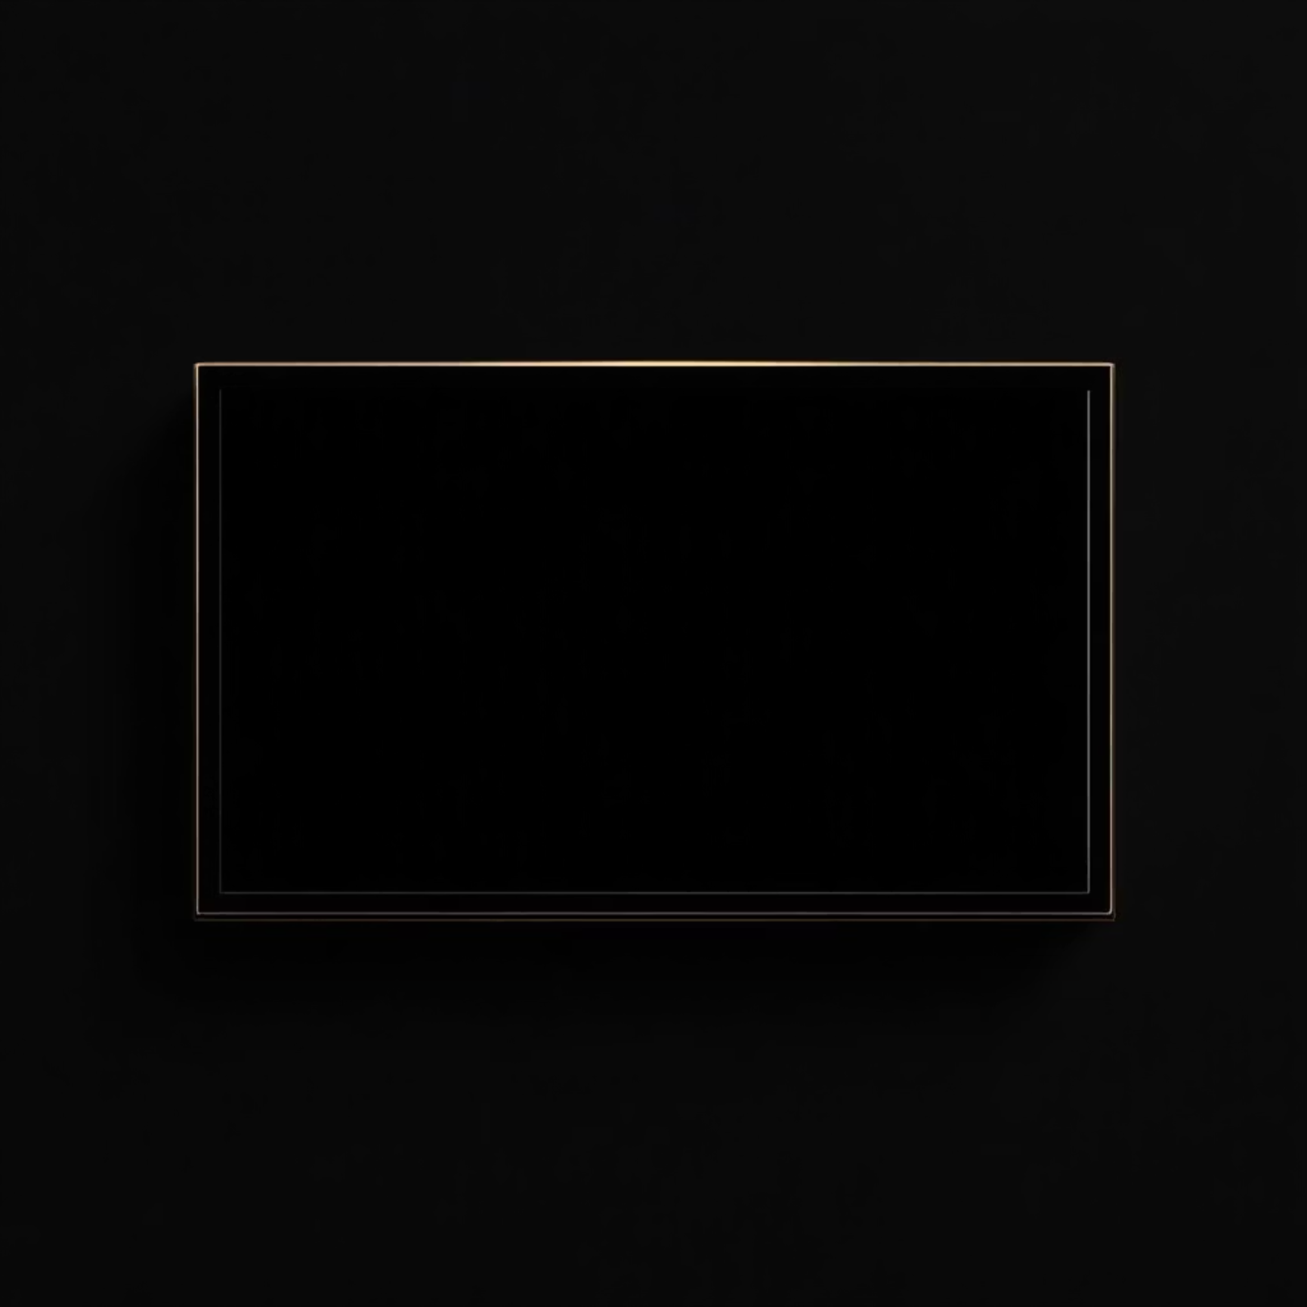
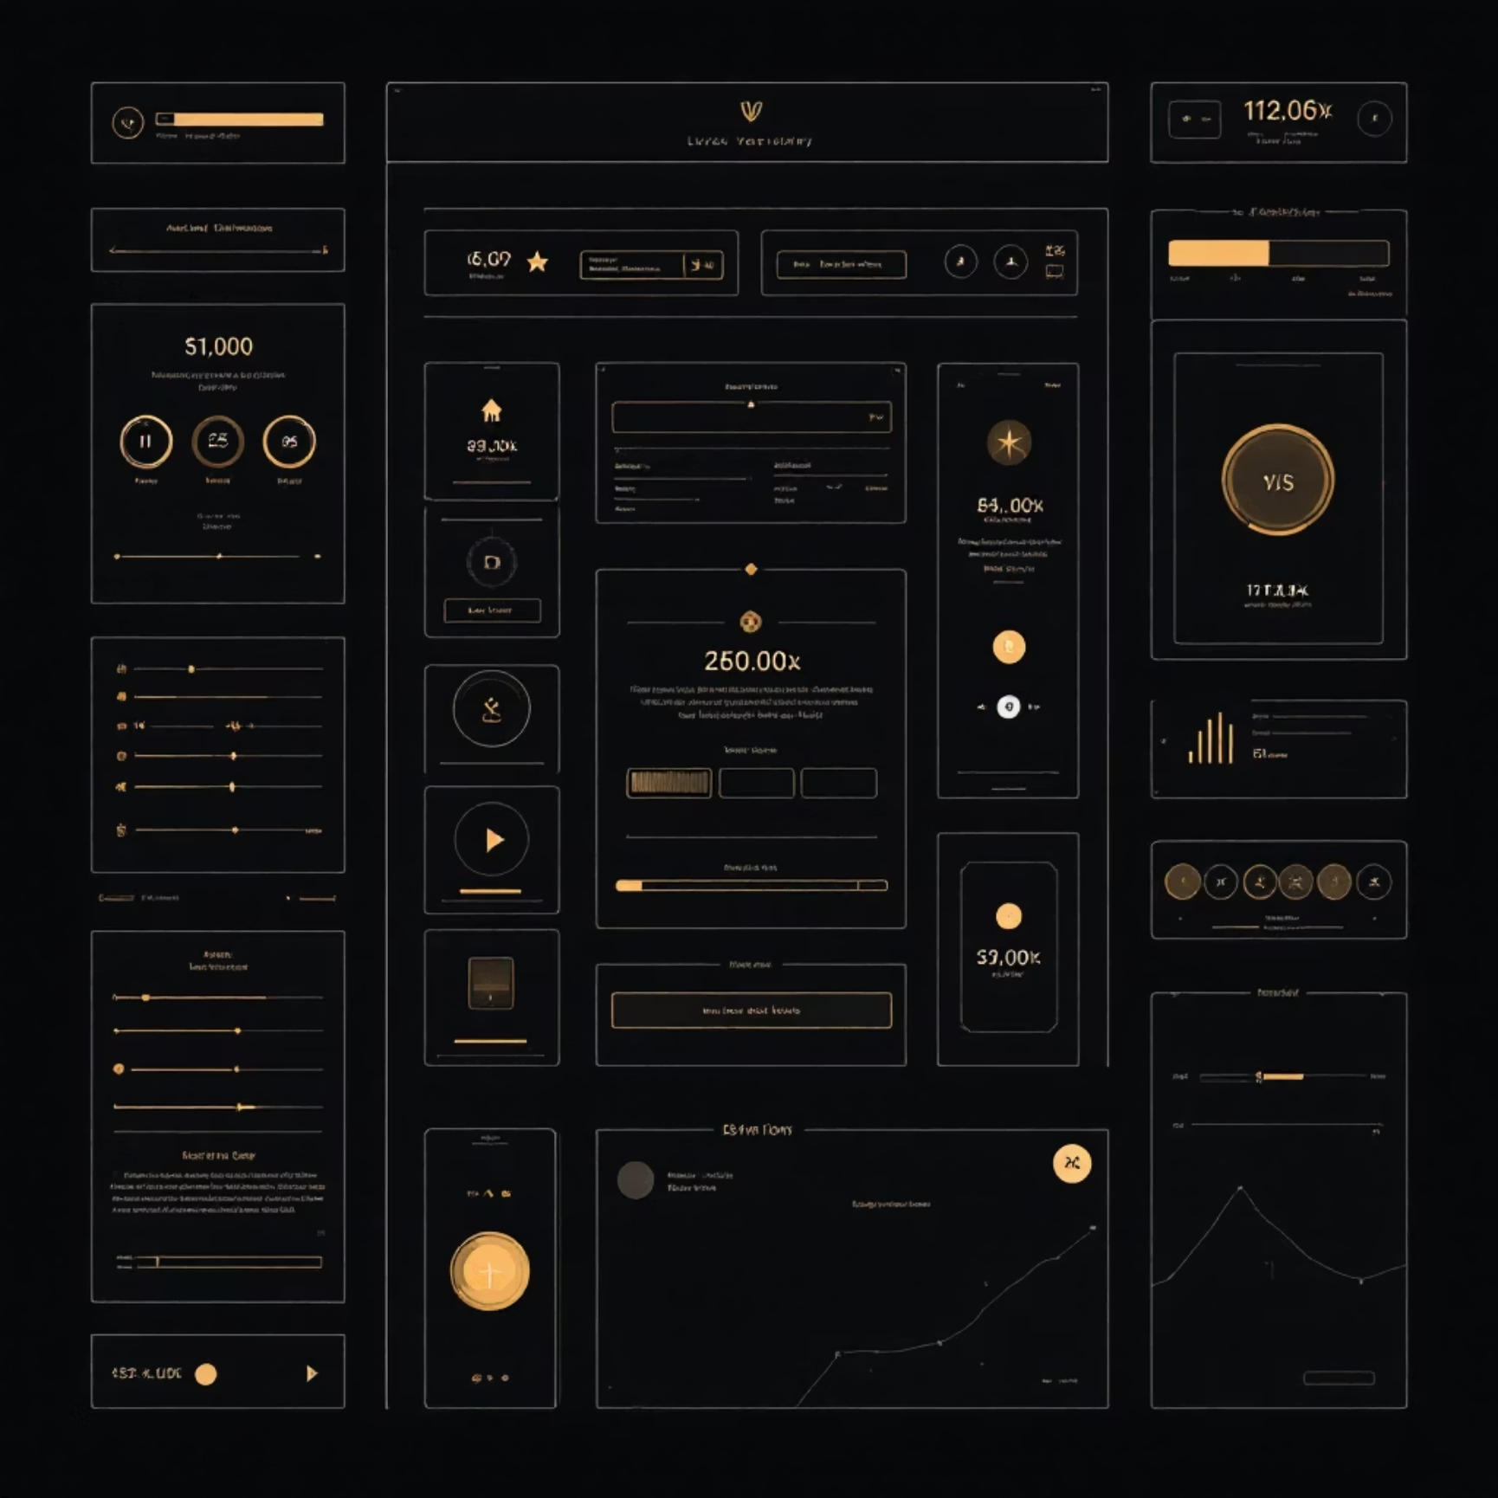
Recap: Basic UI Widgets
Atomic Widgets
The Solution: Layouts
Text, Image, Icon, Container.
Arrange multiple widgets: side-by-side, vertically, or on top.
Appear one at a time or fill the screen.
Essential for real app building.

Slide 4

1. The Column Widget
Arranges children vertically (top to bottom).
Key Properties:
children: List of widgets.
mainAxisAlignment: Controls vertical alignment.
crossAxisAlignment: Controls horizontal alignment.
Analogy: A vertical list or totem pole.

Slide 5
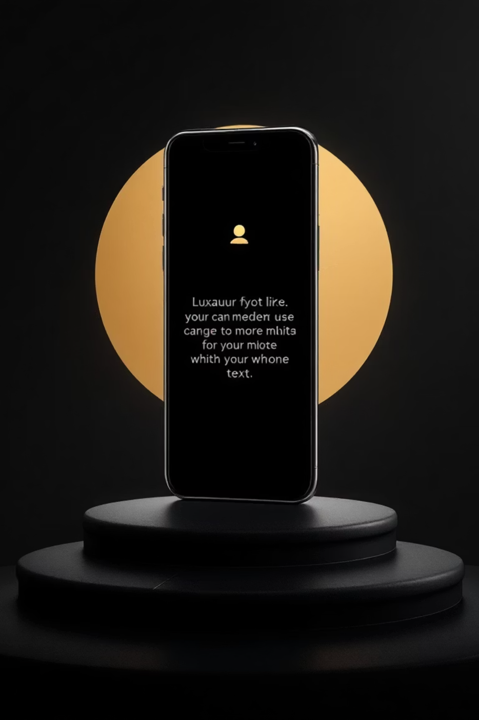
Column Code
Column(
mainAxisAlignment: MainAxisAlignment.center,
children: [
Icon(Icons.star, size: 50),
Text('Title Text'),
Text('Subtitle Description'),
],
)

Slide 6

2. The Row Widget
Arranges children horizontally (left to right).
Key Properties:
Identical to Column, but axes swapped.
mainAxisAlignment: Controls horizontal alignment.
crossAxisAlignment: Controls vertical alignment.
Common Issue: "Yellow/Black overflow warning" if children are too wide.

Slide 7
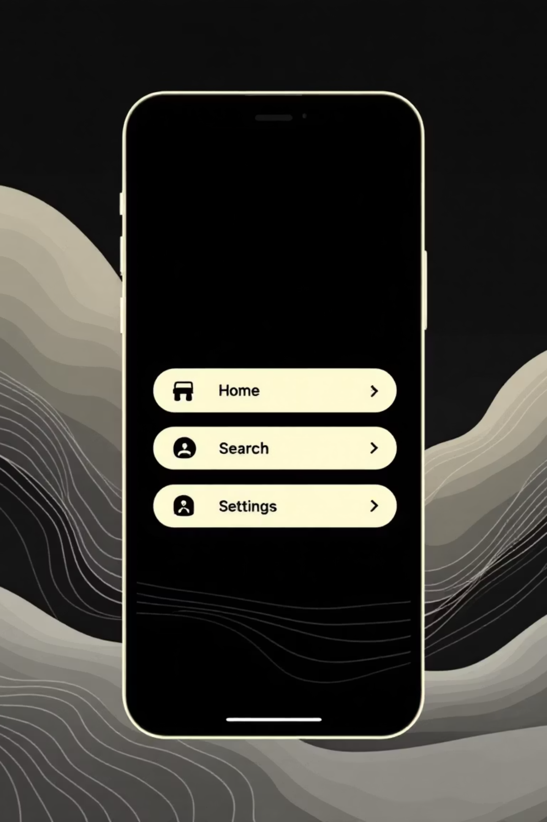
Row Code
Row(
mainAxisAlignment: MainAxisAlignment.spaceEvenly,
children: [
Icon(Icons.home),
Icon(Icons.search),
Icon(Icons.settings),
],
)

Slide 8
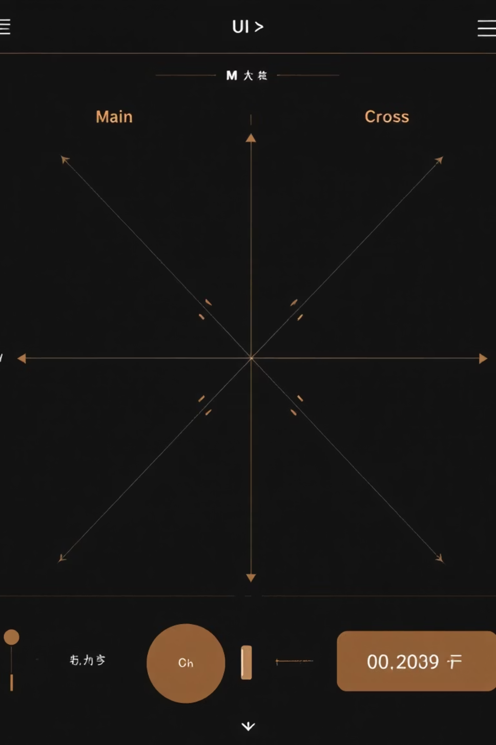
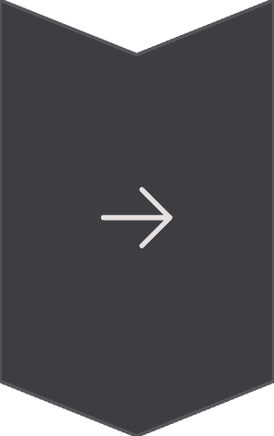

Understanding Axes
For Row
Main Axis: Horizontal (Left-Right).
Cross Axis: Vertical.
For Column
Main Axis: Vertical (Top-Bottom).
Cross Axis: Horizontal.
Visual Tip: Main Axis is the direction widgets flow.

Slide 9
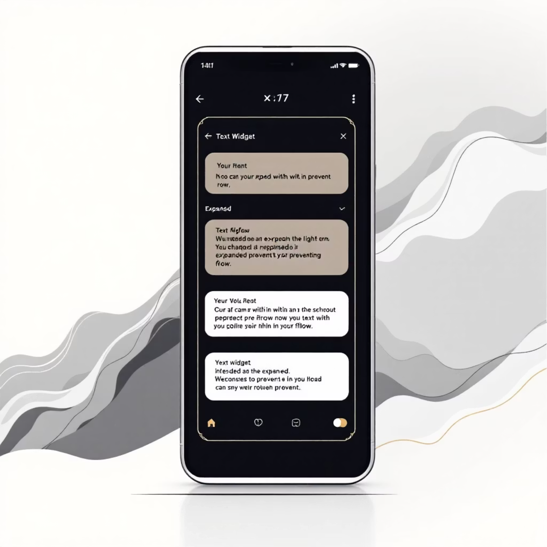
Handling Space: Expanded Widget
Used inside Row or Column.
Makes a child fill available space.
Solves overflow warnings.
Example:
Expanded text in a Row takes remaining width, pushing other elements.

Slide 10
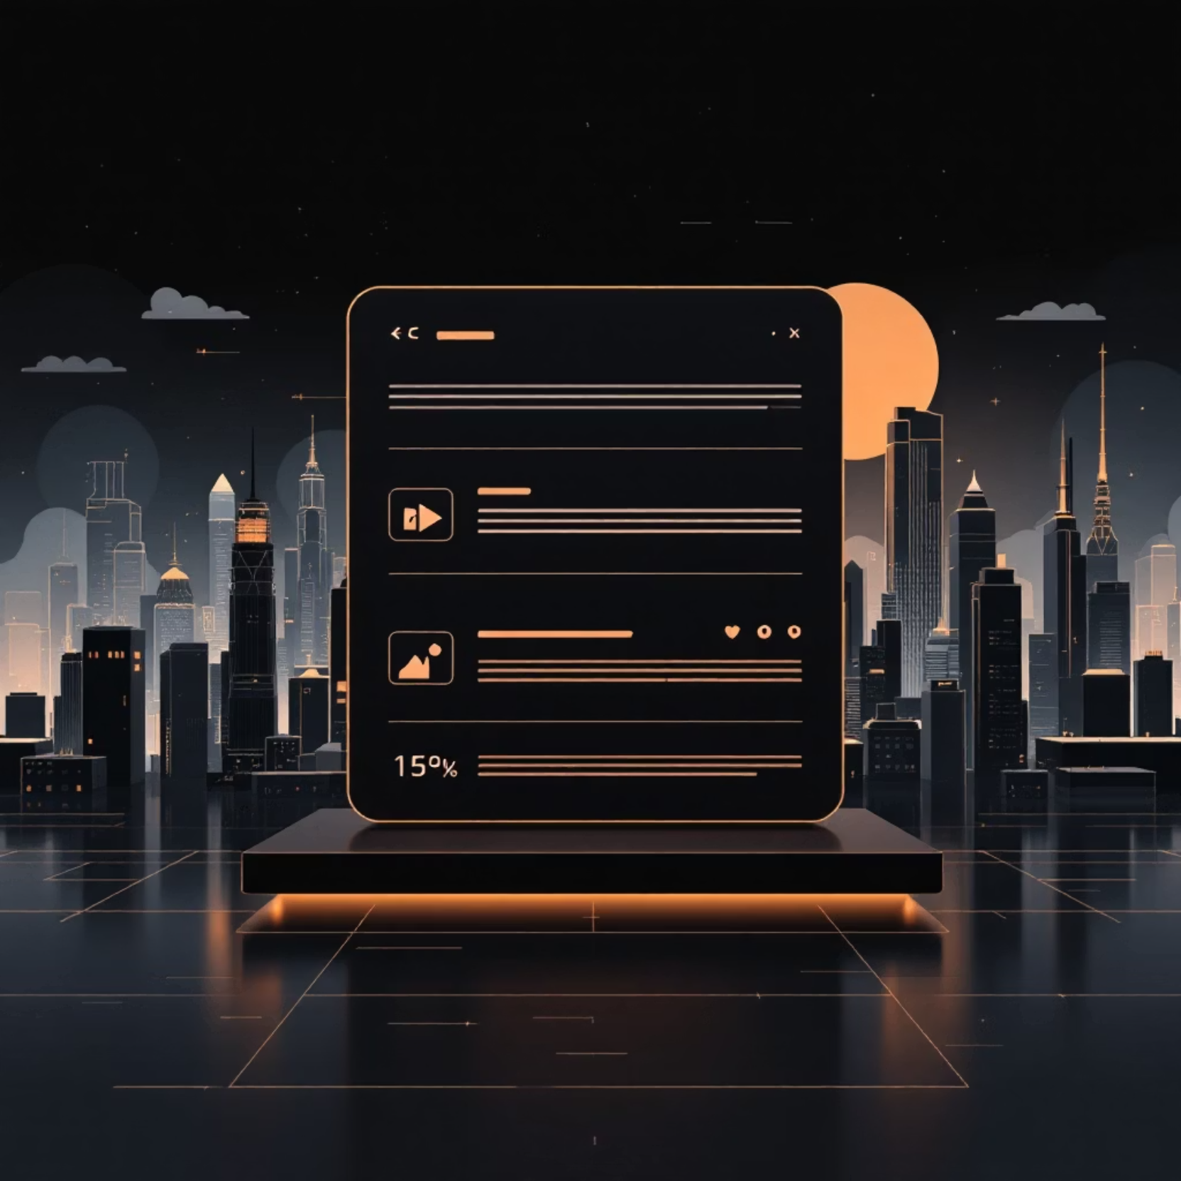
3. The Stack Widget
Arranges children on top of each other (Z-axis).
Use Cases:
Background images with text overlays.
Notification badges on icons.
Positioned Widget:
Pins a child to a specific corner within a Stack.

